Slide 1
DEEP LEARNING
NEURAL NETWORK

Slide 2
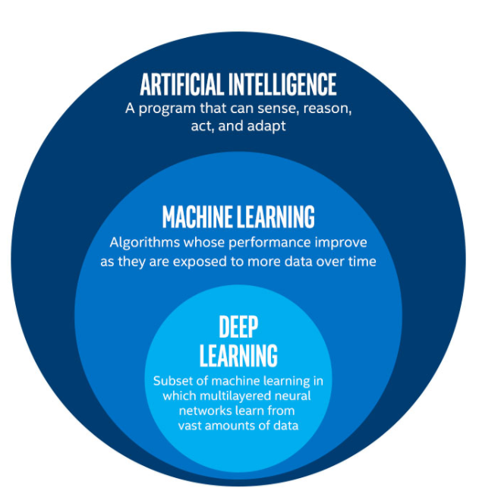
Artificial Intelligence, Machine Learning and Deep Learning

Slide 3
What is Deep Learning?
Deep Learning is the subset of machine learning or can be said as a special kind of machine learning.
It works technically in the same way as machine learning does, but with different capabilities and approaches.
Deep learning models are capable enough to focus on the accurate features themselves by requiring a little guidance from the programmer.
Deep learning is implemented with the help of Neural Networks, and the idea behind the motivation of neural network is the biological neurons, which is nothing but a brain cell

Slide 4
Architectures
Shallow neural network:
The Shallow neural network has only one hidden layer between the input and output.
Deep Neural Networks:
It is a neural network that incorporates the complexity of a certain level, which means several
numbers of hidden layers are encompassed in between the input and output layers. They are highly proficient on model and process non-linear associations

Slide 5
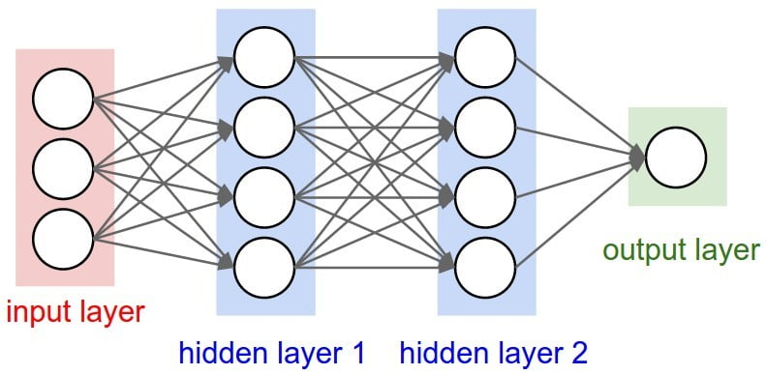

Slide 6
Layers of feed forward neural network
Input layer:
The neurons of this layer receive input and pass it on to the other layers of the network. Feature or attribute numbers in the dataset must match the number of neurons in the input layer.
Output layer:
According to the type of model getting built, this layer represents the forecasted feature.
Hidden layer:
In a neural network, a hidden layer is any layer of neurons between the input layer and the output layer. These layers are called "hidden" because they are not directly exposed to the input or output; rather, they transform the input data into a form that can be used to make predictions or classifications.

Slide 7
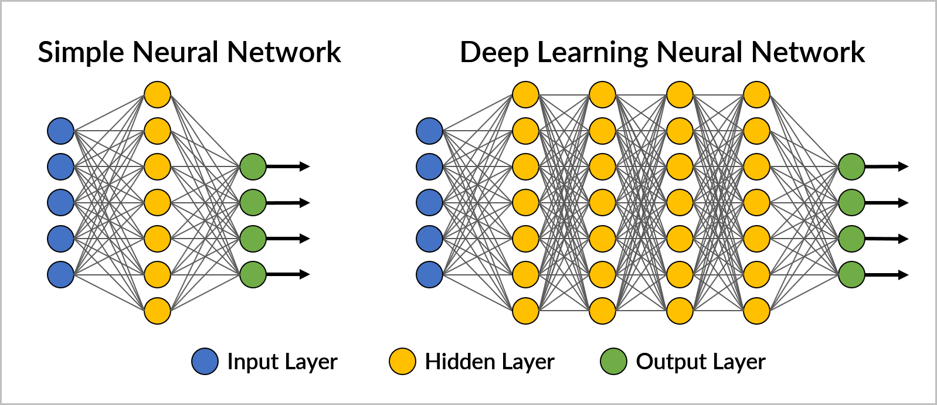

Slide 9
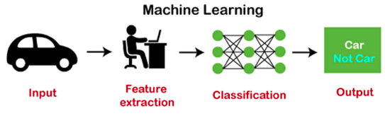
How Machine Learning Works?
The working of machine learning models can be understood by the example of identifying the
image of a cat or dog. To identify this, the ML model takes images of both cat and dog as input, extracts the different features of images such as shape, height, nose, eyes, etc., applies the classification algorithm, and predict the output.

Slide 10
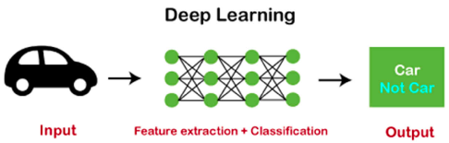
How Deep Learning Works?
We can understand the working of deep learning with the same example of identifying cat vs. dog. The deep learning model takes the images as the input and feed it directly to the algorithms without requiring any manual feature extraction step. The images pass to the different layers of the artificial neural network and predict the final output.

Slide 11
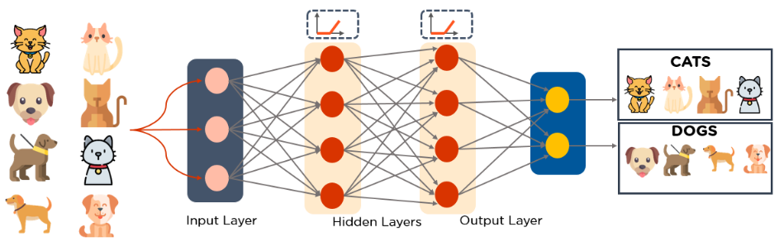

Slide 12
Deep Learning Models
Some popular deep learning models are:
FeedForward Neural Network (FFN)
Convolutional Neural Network (CNN)
Recurrent Neural Network (RNN)

Slide 13
Advantages of Deep Learning:
Automatic feature learning: Deep learning algorithms can automatically learn features from the data, which means that they don’t require the features to be hand-engineered. This is particularly useful for tasks where the features are difficult to define, such as image recognition.
Handling large and complex data: Deep learning algorithms can handle large and complex datasets that would be difficult for traditional machine learning algorithms to process. This makes it a useful tool for extracting insights from big data.
Improved performance: Deep learning algorithms have been shown to achieve state-of-the-art performance on a wide range of problems, including image and speech recognition, natural language processing, and computer vision.
Handling non-linear relationships: Deep learning can uncover non-linear relationships in data that would be difficult to detect through traditional methods.

Slide 14
FeedForward Neural Network
MultiLayer Perceptron

Slide 15
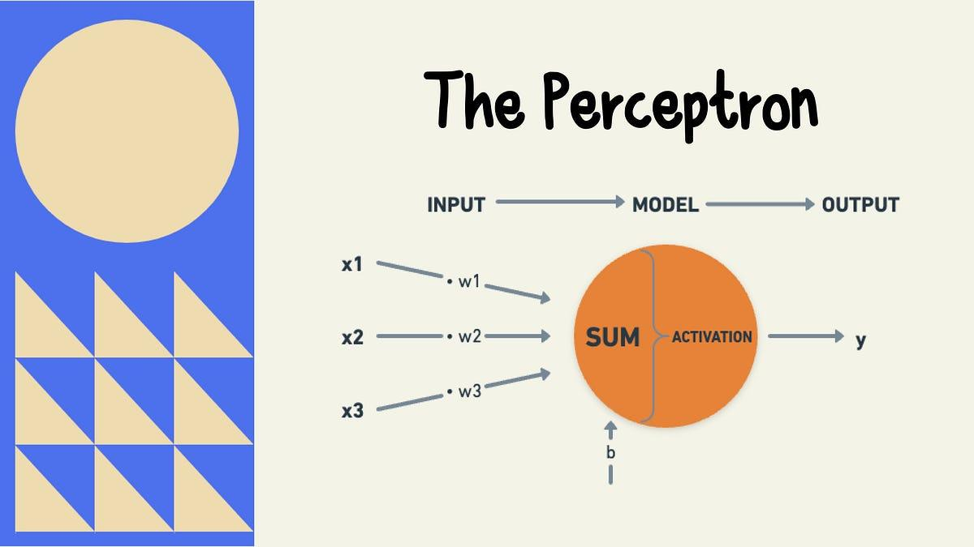
FeedForward Neural Network

Slide 16
Basic Components of Perceptron
Input Features
Weights
Bias
Summation Function
Activation Function
Learning Algorithm (Weight Update Rule)

Slide 17
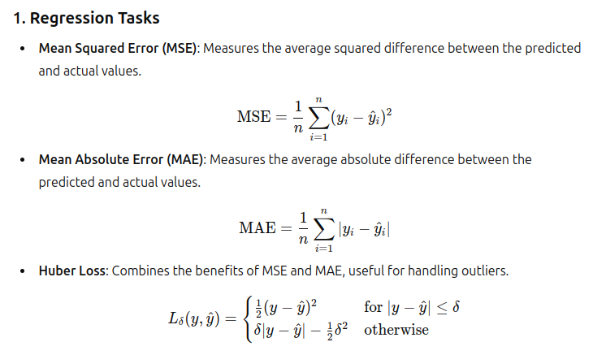
Cost Function

Slide 18
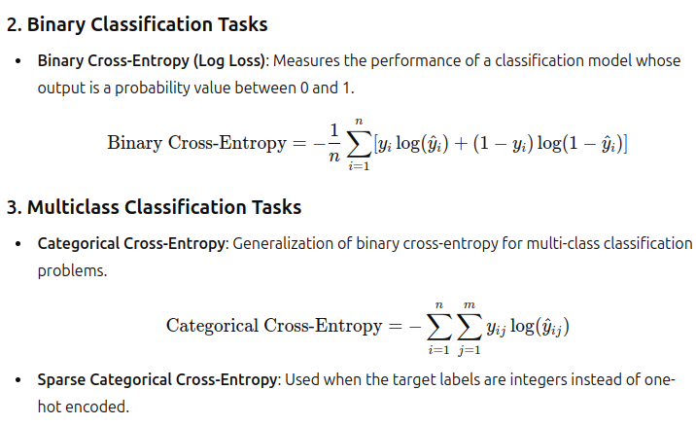

Slide 19
Activation Function
Step function
Sigmoid/Logistic function
Softmax function
tanh function : values in the range -1 to 1
ReLU function

Slide 20
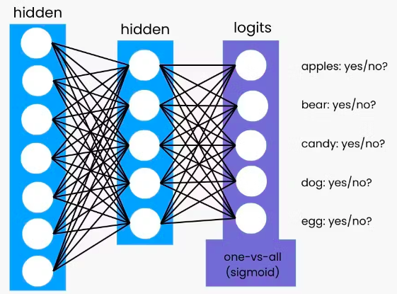

Slide 21
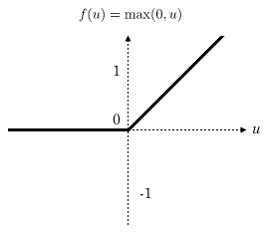
ReLU (Rectified Linear Unit)
ReLU is a popular activation function used in neural networks, especially deep learning models. It introduces non-linearity into the model, enabling it to learn complex patterns.
Non-Linearity
Simplicity and Efficiency
Reduced Vanishing Gradient Problem

Slide 22
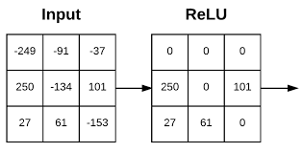

Slide 23
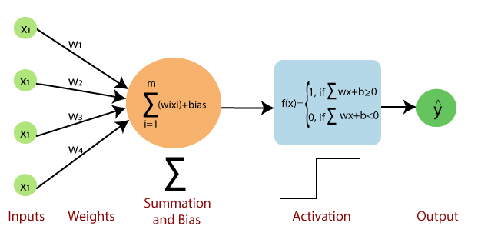

Slide 25
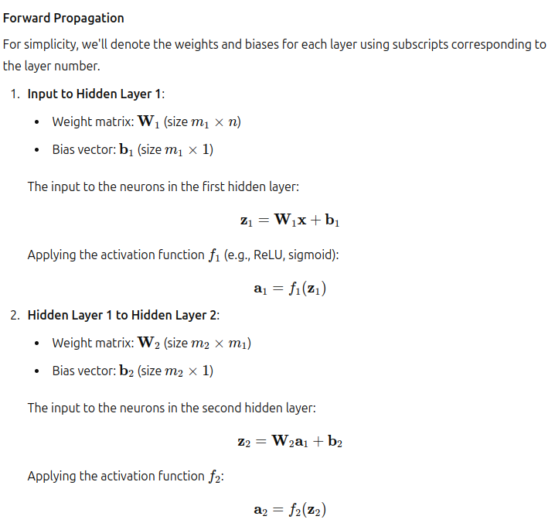
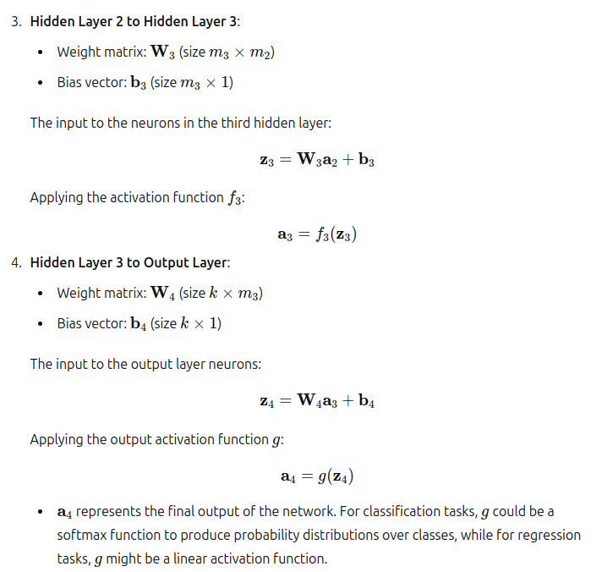

Slide 26
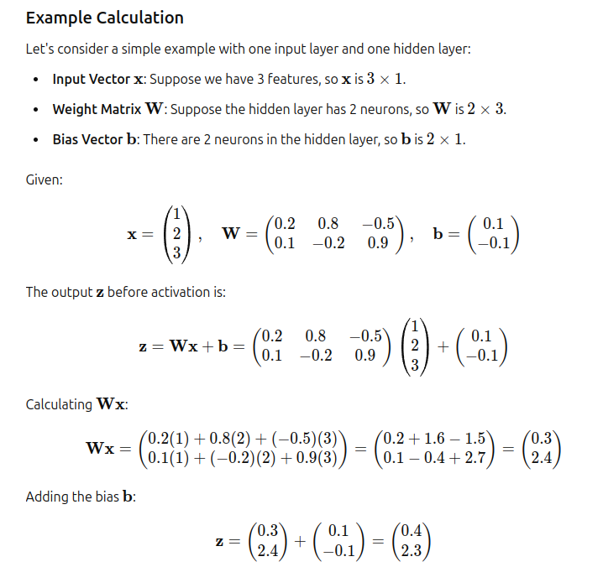
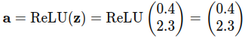

Slide 27
Reference
https://medium.com/@SSiddhant/the-mathematics-of-neural-networks-a-complete-example-65f2b12cdea2
https://www.youtube.com/watch?v=aircAruvnKk&t=11s

